Slide 1
THE MSC GROUP
2026

Slide 2
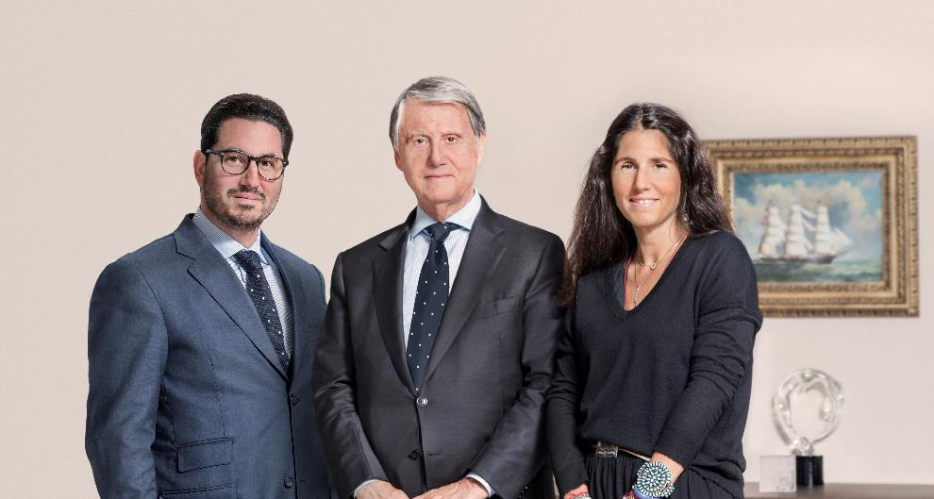
A FAMILY COMPANY
Since 1970, Mr. Gianluigi Aponte has led MSC from its humble one-vessel-operation beginnings, into its current status as a world leader in global container shipping.
The company has seen exponential growth in terms of both volume and fleet capacity, and now serves millions of customers globally, with a much respected 365 day a year operation.
Despite the constant shipping industry consolidation, MSC remains an independent and privately owned company. Our stability allows us to build long-term relationships with all our customers.
Today, the Group employs over 200,000 people around the world.
Mr. Diego Aponte
Group President
Capt. Gianluigi Aponte
Group Chairman
Mrs. Alexa Aponte Vago
Group Chief Financial Officer
“OURS IS A BUSINESS BUILT ON A GENUINE PASSION FOR THE SEA.”
Captain Gianluigi Aponte

Slide 3













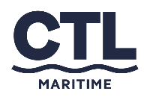






MSC GROUP
OVERVIEW
CARGO DIVISION
PASSENGER DIVISION
CRUISE DIVISION
FERRY DIVISION
Rail DIVISION
OTHER ENTITIES

Slide 4
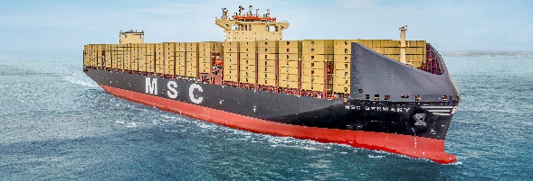
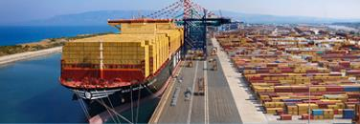
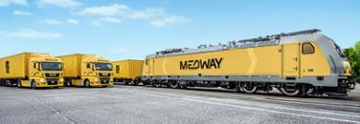
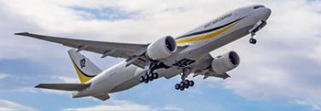
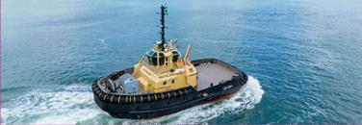
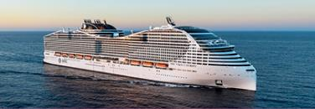
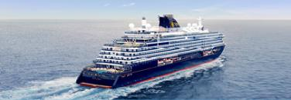
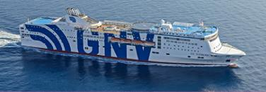
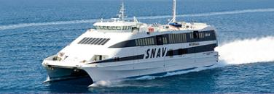
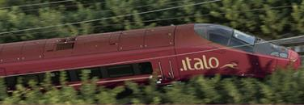
MSC GROUP
KEY NUMBERS 2026
CARGO DIVISION
Leading shipping conglomerate
No 1 shipping line worldwide
1,000 vessels
300 routes
520 ports of call
30 million TEUs carried annually
100+ terminals (all MSC Group entities)
7 aircraft (1 to be delivered in spring 2026)
675 offices
155 countries
PASSENGER DIVISION
CRUISE DIVISION - Two brands: MSC Cruises in the contemporary segment, and Explora Journeys in luxury
MSC Cruises
27 ships by the end of 2030
Sailing to 100+ countries & 300+ destinations
185 nationalities welcomed on board
5M guests sailed in 2025
Explora Journeys
  The luxury ocean travel brand was launched in July 2023
  3 ships in operation by summer 2026
  A total fleet of 6 ships by end of 2028
Worldwide, the MSC Group has over 200,000+ staff on board and ashore (all entities combined).

Slide 5


FINDING SUSTAINABLE SOLUTIONS
TO ADDRESS GLOBAL CHALLENGES, TOGETHER
The MSC Group’s strong core values are reflected
by our long-term commitment to sustainable development.
With more than 50 years of experience at sea,
we regard sustainability as a strategic imperative and, above all, a business priority.
We are committed to our decarbonization pathway towards the target of net zero decarbonization by 2050.
msc.com/sustainability
msccruises.com/sustainability
explorajourneys.com

Slide 6
CARGO DIVISION

Slide 7
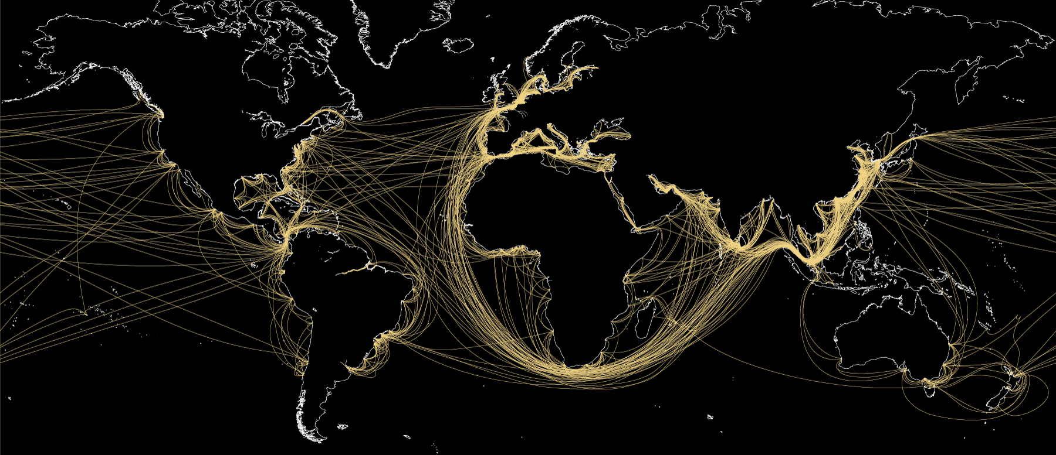
MSC MEDITERRANEAN SHIPPING COMPANY
A UNIQUE WORLDWIDE PRESENCE

Slide 8
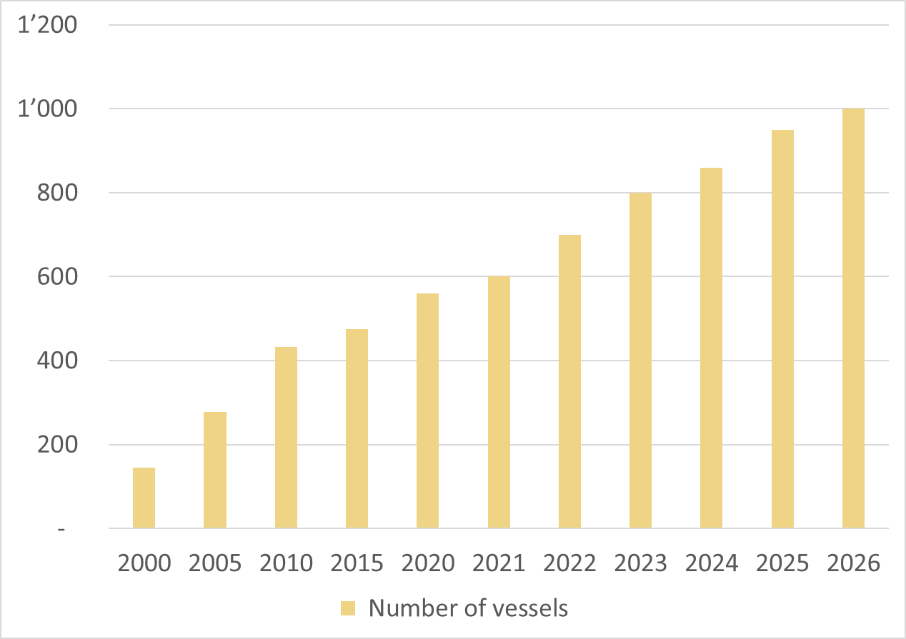
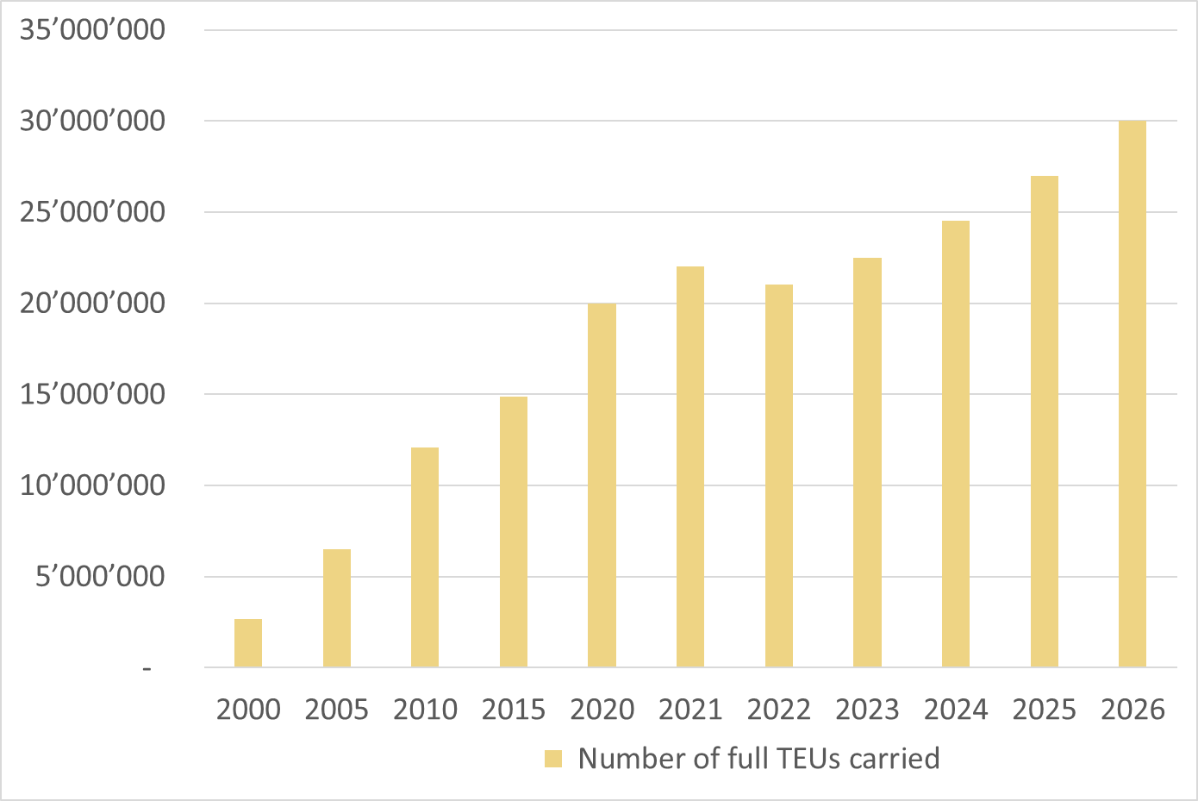
MSC’s GROWTH
MSC FLEET
TEUs CARRIED
EST. 30 MILLION
EST. 1,000
27 MILLION
950
850
24.5 MILLION

Slide 9
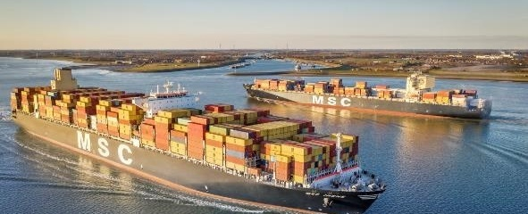
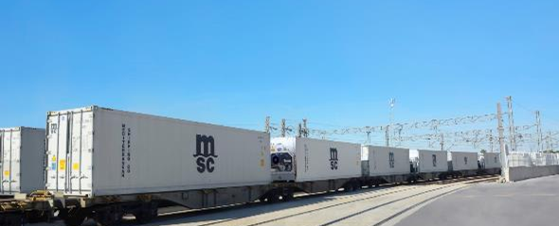

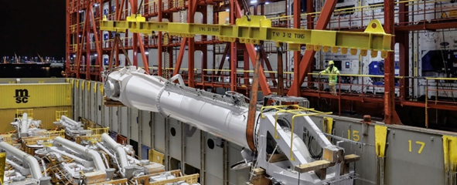
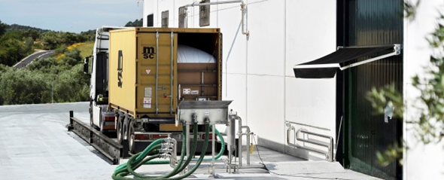
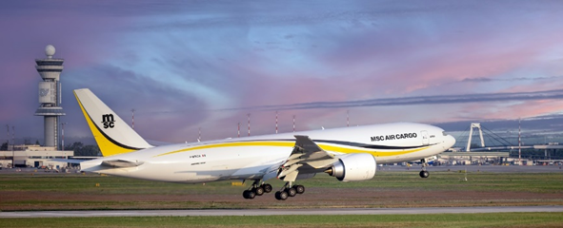

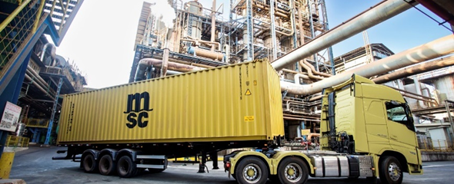

MSC SOLUTIONS msc.com/solutions
SHIPPING  INLAND TRANSPORTATION & LOGISTICS  DIGITAL BUSINESS  CARGO COVER
TRADE SERVICES
REEFER / RAIL
MSC iREEFER
PROJECT CARGO
LIQUID CARGO
MSC AIR CARGO
BIOFUEL
CARGO COVER
DIGITAL BUSINESS

Slide 10

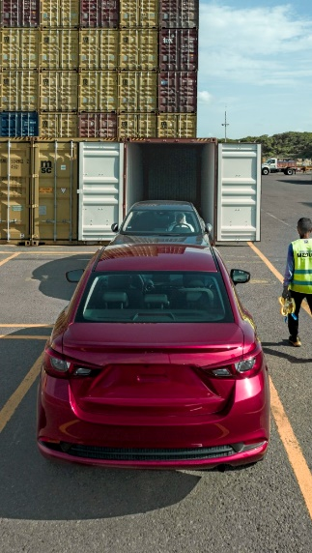














MSC’S industry-specific expertise
MSC has become the trusted transportation partner for so many of the world’s most prestigious companies, delivering countless cargoes and commodities with the utmost care.
MINING
& MINERALS
PULP, PAPER
& FORESTRY
PHARMA
CHEMICALS
FOOD
& BEVERAGES
PLASTICS
& RUBBER PRODUCTS
AGRICULTURE
AUTOMOTIVE
RETAIL

Slide 11
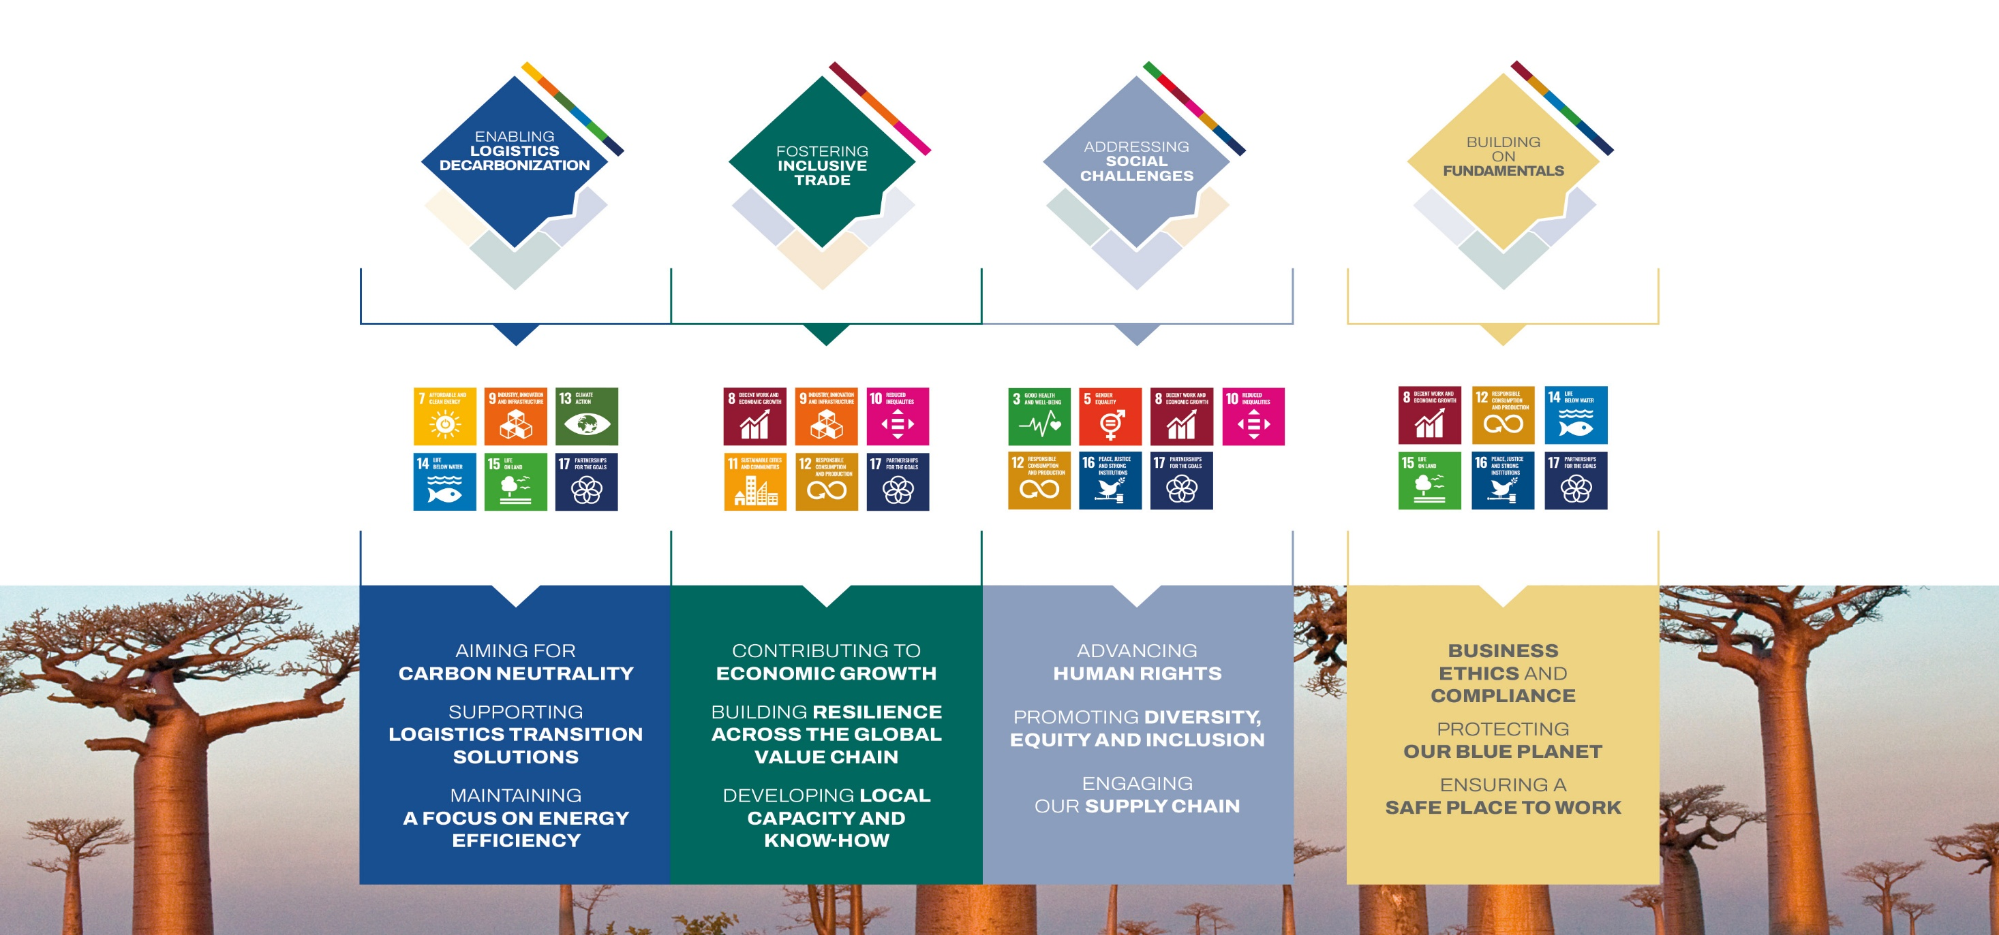
Our sustainability priorities msc.com/sustainability

Slide 12
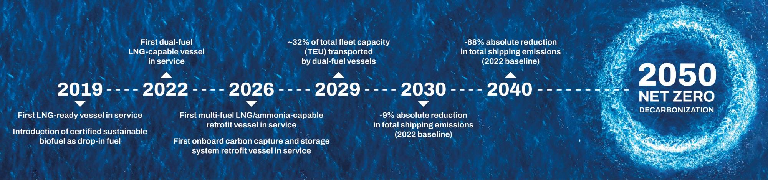
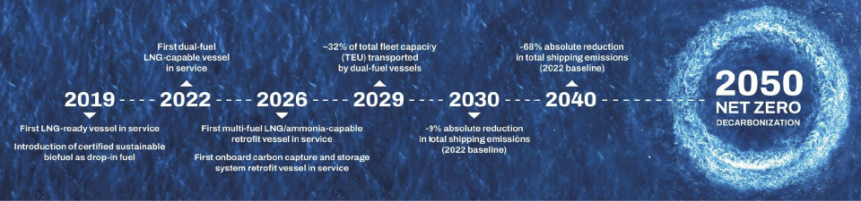
Our DECARBONIZATION PATHWAY TOWARDS NET-ZERO SHIPPING
MSC is committed to an energy transition targeting net-zero decarbonization by 2050. ​
We envisage a net-zero future that will see shipping draw on a combination of fuels, and our focus is on ensuring the readiness of our fleet to adopt zero-carbon fuels as they become available. ​
We are investing today in a combination of fuel and technology solutions towards the achievement of our net-zero target: ​
MSC’s fleet will continue to expand with the delivery of over 150 dual-fuel LNG newbuilding vessels in the coming years that will support the transition to bio- and synthetic methane.​
By the end of 2024, approximately 63% of MSC’s total fleet capacity (TEU) was equipped to connect to onshore power supply and connect to the local electricity grid.​
We continue investing and collaborating with partners, conducting research, trials and pilots focused on accelerating innovation and scaling up production of specific fuels and technologies.​

Slide 13
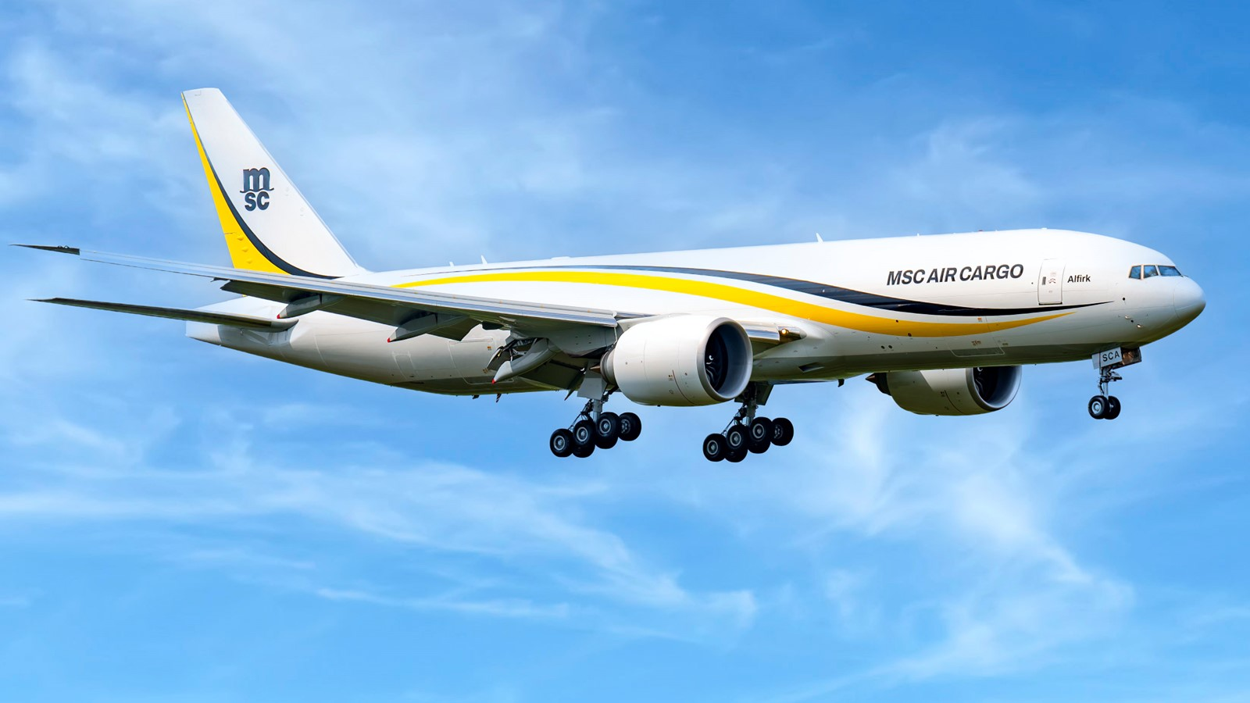
MSC AIR CARGO mscaircargo.com
7
21
2,885
AIRCRAFT
(last one will be delivered in March ‘26)
STATIONS WORLDWIDE
FLIGHTS
IN 2025
MSC Air Cargo is the latest addition to MSC's expansive logistics portfolio, created to meet the surging demand for efficient air cargo solutions. Launched in December 2022, our MSC-branded Boeing 777-200F aircraft operate scheduled flights linking Asia, Americas, and Europe.
Renowned for reliability and fuel efficiency, our modern fleet accommodates both scheduled and ad hoc air cargo routes, serving diverse industries and commodities.
Operating on a point-to-point network with gateways and cross-over points strategically aligned with trade corridors, we offer special cargo products complemented by extended road feeder (trucking) services, facilitating seamless global connections via regular flight routes between key continents.

Slide 14
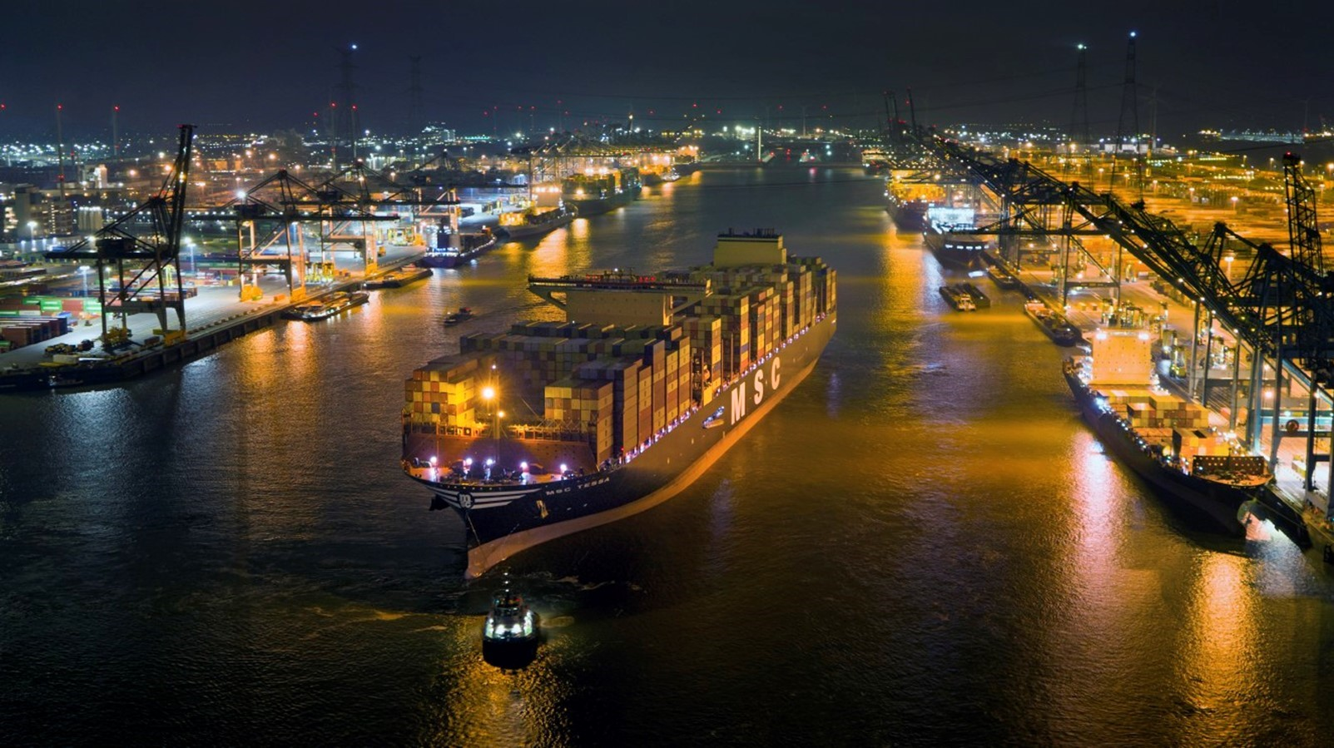

TiL (TERMINAL INVESTMENT LIMited)
TILGROUP.COM
One of the world’s largest and most geographically diverse container terminal operators
100+ terminals worldwide (MSC Group)
Present at 10 of the world’s 30 busiest ports by volume: Singapore, Ningbo, Busan, Rotterdam, Antwerp, Los Angeles, Long Beach, Newark (New York-New Jersey), Mundra and Hai Phong*
Active in 36 countries across 5 continents
41 million moves per year (68 million TEUs)
*source: www.worldshipping.org/top-50-ports

Slide 15
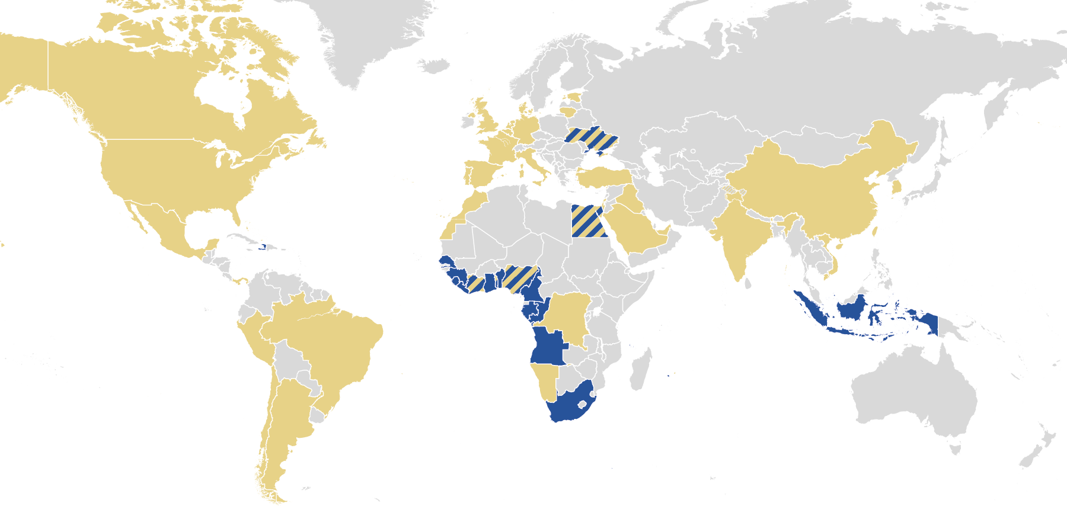
Presence in the main ports of the world
AGL’s TERMINALS
Abidjan (Côte d'Ivoire)(ATL, CIT, Terra)
Cape Town (South Africa)
Cotonou (Bénin)
Conakry (Guinea)
Dakar (Senegal)
Dili (Timor-Leste)
Freetown (Sierra Leone)
Kribi (Cameroon)
Lagos (Nigeria) (TICT)
Libreville (Gabon) (OCT)
Lobito (Angola)
Lomé (Togo)
Malindi (Zanzibar)
Monrovia (Liberia)
Moroni (Comoros)
Odessa (Ukraine)
Patimban (Indonesia)
Pointe Noire (Congo)
Port-au-Prince (Haiti)
Port-Saïd (Egypt)
Tema (Ghana) (MPS)
Walvis Bay (Namibia)
OUR GLOBAL PRESENCE (TiL & MSC)
ARGENTINA
Buenos Aires
BAHAMAS
Freeport
BELGIUM
Antwerp
BRAZIL
Navegantes
Rio de Janeiro
Santos
Vitoria
CANADA
Halifax
Montreal
CHILE
Valparaiso
CHINA
Ningbo
CÔTE D’IVOIRE
San Pedro
DEMOCRATIC
REPUBLIC OF CONGO (DRC)
Matadi
DENMARK
Aarhus
EGYPT
Alexandria
ESTONIA
Muuga/Tallin
FRANCE
Fos-sur-Mer
La Réunion
Le Havre
GERMANY
Bremerhaven
Hamburg
INDIA
Ennore
Mundra
IRAQ
Umm Qasr
ISRAEL
Ashdod
ITALY
Ancona
Civitavecchia
Genoa
Gioia Tauro
La Spezia
Leghorn
Naples
Ravenna
Trieste
Venice
LITHUANIA
Klaipeda
MEXICO
Altamira
MOROCCO
Tangier
Nador
NAMIBIA
Walvis Bay
NETHERLANDS
Rotterdam
NIGERIA
Tin Can
PANAMA
Cristobal
Panama
PERU
Callao
Paracas
PORTUGAL
Sines
SAUDI ARABIA
King Abdullah
SINGAPORE
SOUTH KOREA
Busan
SPAIN
Bilbao
Las Palmas
Valencia
TOGO
Lomé
TÜRKIYE
Aliaga
Asyaport
Iskenderun
Istanbul
UAE
Abu Dhabi
UK
Liverpool
London
UKRAINE
Odessa
USA
Baltimore
Houston
Long Beach
Los Angeles
Newark
New Orleans
Port Everglades
Seattle
VIETNAM
Haiphong
Note: In green, TiL’s greenfield terminals,
in yellow Top 30 terminals in terms of volume

Slide 16
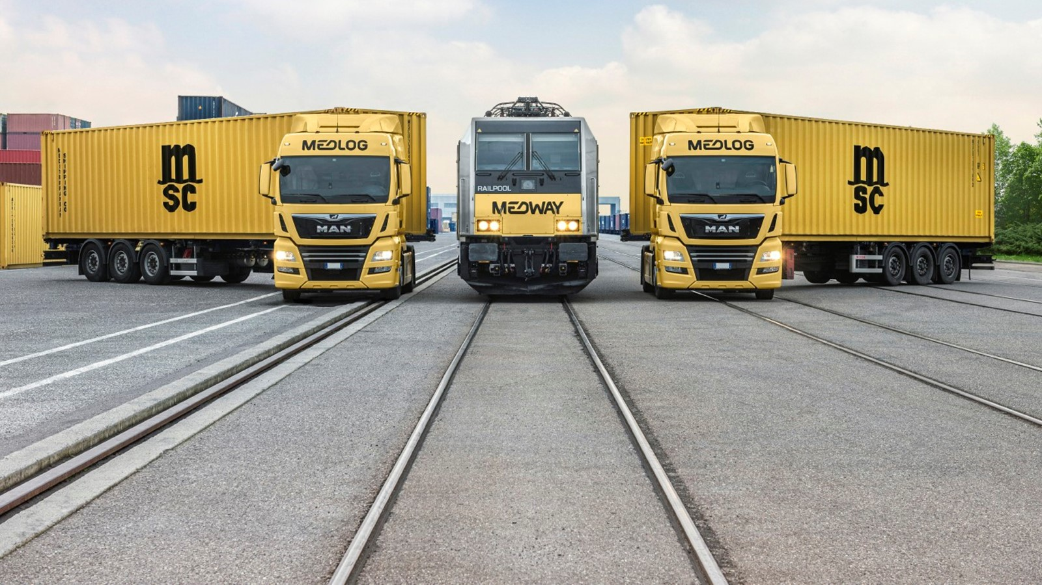

MEDLOG medlog.com
ONE OF THE WORLD’S GEOGRAPHICALLY WIDEST LOGISTICS AND SUPPLY CHAIN PROVIDERS
MEDLOG acts as an independent company in over 90 countries worldwide.
Offering unparallelled global coverage, we create reliable, tailor-made solutions via our own fleet, assets and infrastructure. By constantly expanding and investing in new technology, we help customers optimize their supply chain, save costs and reduce their environmental impact.
MEDWAY is the entity dealing with rail operations.
MEDLOG’s portfolio of solutions includes:
Inland transport solutions - Inland infrastructure - Value-added solutions

Slide 17
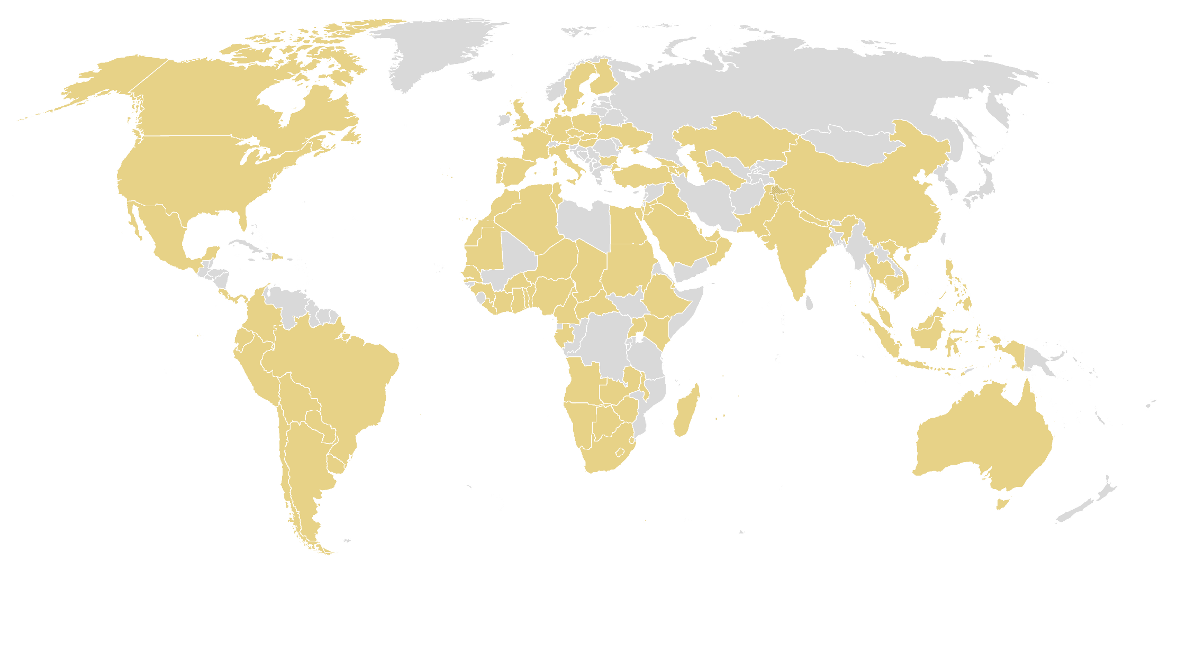
MEDLOG
GLOBAL LEADER IN INLAND LOGISTICS
90+
OPERATING COUNTRIES
485
OPERATING
SITES
10M+ TEUs
TRANSPORTED ANNUALLY
22M SQM
OVERALL CAPACITY
INLAND TRANSPORTATION
Transport solutions by
  truck
  rail
  barge
INLAND INFRASTRUCTURE
Inland Container Depots
(incl. garment racks, flexibags, etc.)
Container Freight Stations (CFS)
Cold Storage, Dry Warehousing and Distribution
VALUE-ADDED SOLUTIONS
Customs House Brokerage
Reefer Services
Project Cargo and Industrial Logistics
Port Agent/Ship Consignment
Weighing and Fumigation
Automotive Container Shipping

Slide 18
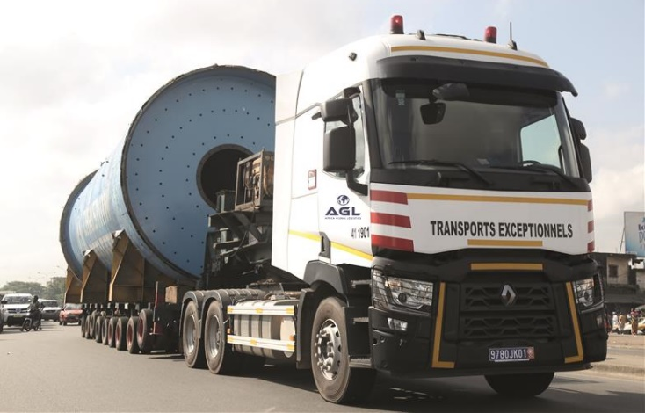
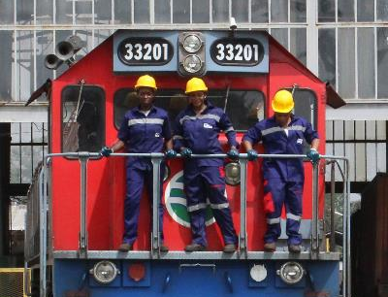
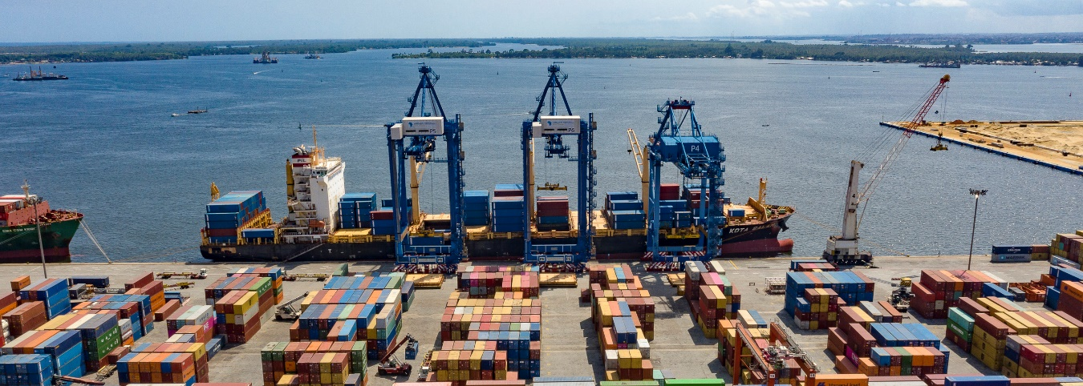
AFRICA GLOBAL LOGISTICS (AGL)
AGLGROUP.COM
AGL provides its African and global customers with global, customized and innovative logistics solutions, with the goal of contributing in a sustainable way to Africa’s major transformations. AGL is also present in Haiti, East Timor and Indonesia.
AGL’s offering covers:
Port terminals
Rail concessions
Its vertical expertise encompasses various sectors:
Energy, mining, FMCG-food-retail, soft commodities, aid & relief-healthcare, high tech & telecom, industrial & infrastructures, aerospace.
Logistics to industries and traders
Shipowner, liners and tramps
KEY NUMBERS
51 | 24 | 294 | 4.8K | 2 | 135 | 66 | 23K+
COUNTRIES | PORT CONCESSIONS | SITES CFS / COMMODITIES WAREHOUSES (900K sqm) | ONSHORE FLEET | RAILWAY CONCESSIONS | CONTRACT LOGISTICS SITES WAREHOUSES (700K sqm) | DRY PORTS | EMPLOYEES

Slide 19
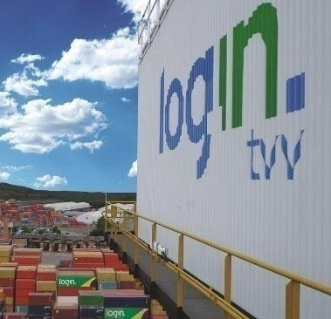
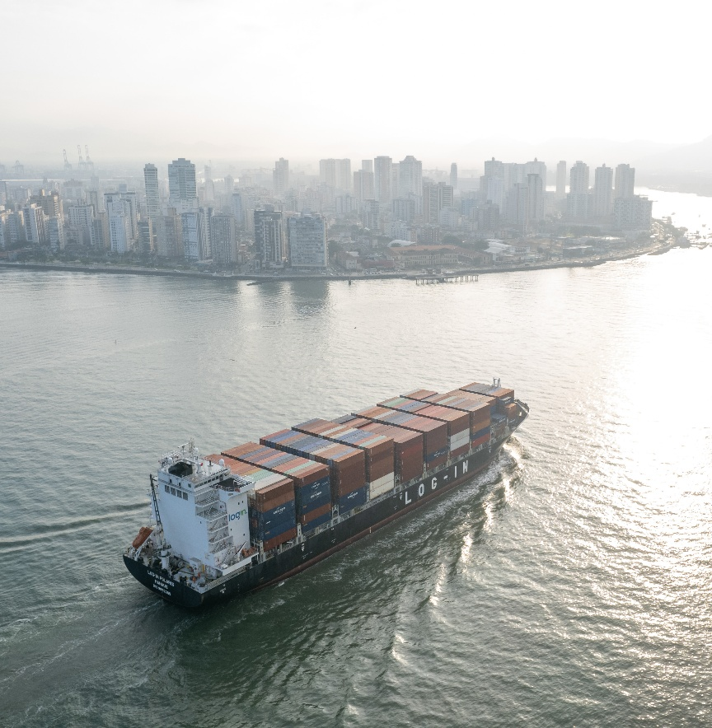
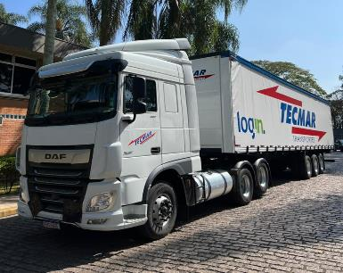
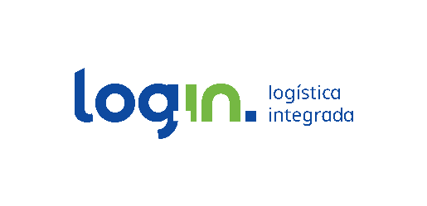
Log-IN Logística INTEGRADA www.loginlogistica.com.br
Log-In is a leading Brazilian shipping company headquartered in Brazil and a local integrated logistics operator in South America.
Specialized in cabotage, Log-In currently operates 9 vessels along the Brazilian coast, interconnecting the main ports of Brazil, Argentina, Paraguay and Uruguay – from Manaus to Mercosur. In addition, Log-In offers:
Marine terminal services in the State of Espírito Santo through TVV (Vila Velha Terminal)
Customized logistics solutions, offering multimodal warehousing and terminal operations.
Road transportation (through Tecmar and Tecmar Norte)
KEY NUMBERS
9+ | 1.3K | 1 | 1 | 50 | 24K TEUs | 34 | 3K+
VESSELS | VEHICLES | PORT TERMINAL | INTERMODAL TERMINAL | WAREHOUSES ACROSS BRAZIL | MARITIME TRANSPORT CAPACITY | OFFICES | EMPLOYEES

Slide 20
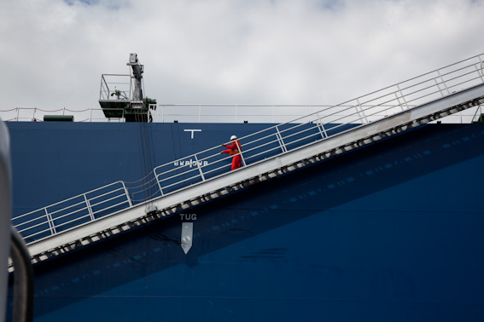
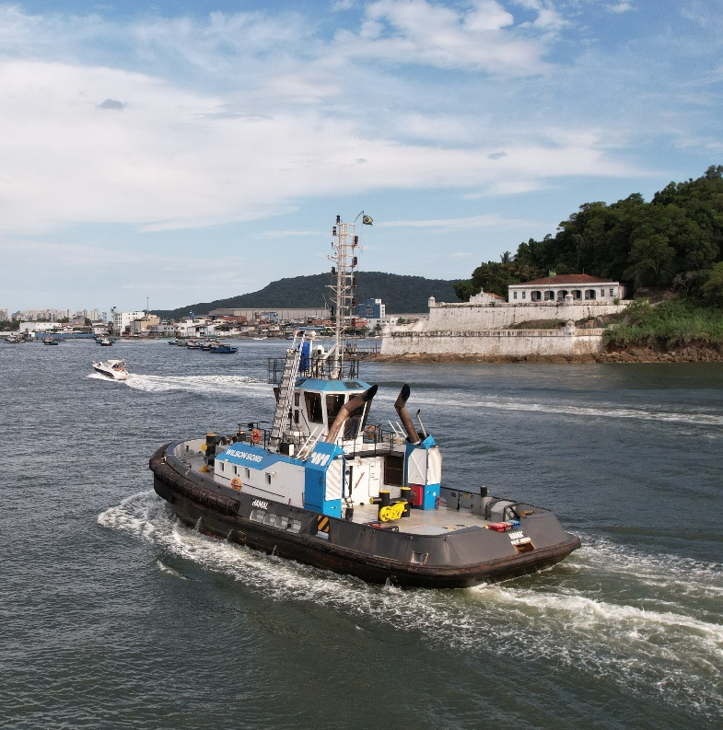
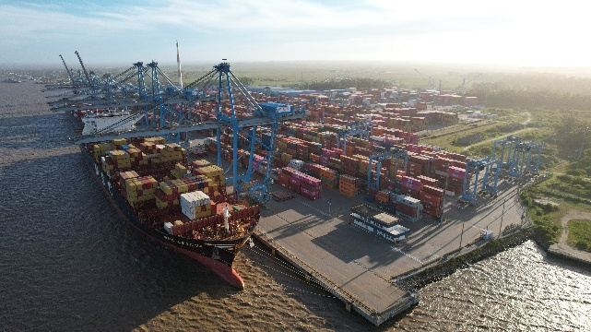

WILSON SONS
WWW.wilsonsons.com.br
Recognized for its extensive experience of over 188 years, Wilson Sons covers the entire Brazilian territory and offers complete solutions for a wide range of customers, including carriers, importers and exporters, the offshore energy industry, renewable energy projects, the agribusiness sector, and other participants in various segments of the economy.
Its structure includes:
Container Port Terminals
Towage
Logistics Centre
Shipping Agency
Shipyard
Offshore Support Vessels and Bases
NVOCC (Non-Vessel Operating Common Carrier)
KEY NUMBERS
+4K | 2 | 1 | +80 | 1 | 21 | 1 | 2 | 1
EMPLOYEES | CONTAINER TERMINALS | INLAND WATER TRANSPORT CONTAINER TERMINAL | TUGBOATS | LOGISTICS CENTRE | SHIPPING AGENCY BRANCHES | SHIPYARD | OFFSHORE SUPPORT BASES | NVOCC

Slide 21
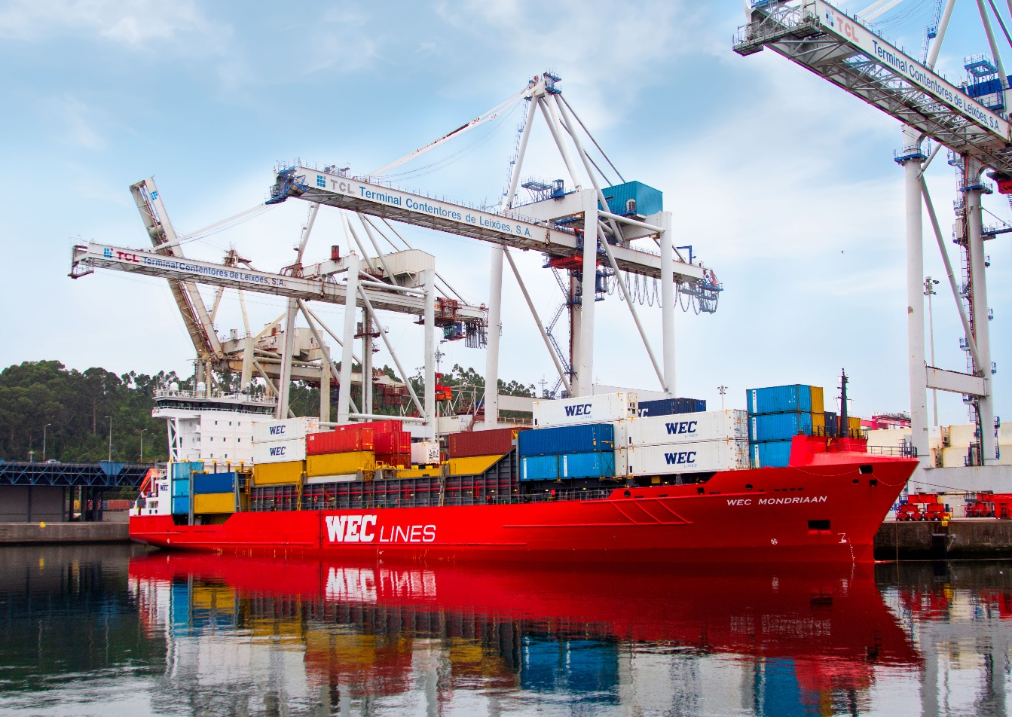

WEC LINES weclines.com
WEC Lines is a medium-sized container shipping line with intermodal connections via rail and barge. The company has +50 years of experience in connecting North-western Europe with Southern Europe, North & East Africa and the Red Sea. Headquartered in Rotterdam, WEC Lines has offices in e.g., Felixstowe, Hamburg, Antwerp, Barcelona, Lisbon, Nantes, Casablanca, Mombasa, and Nairobi as well as a large worldwide agency network.
KEY NUMBERS
17 | 543K | 22K | 20 | 400
SHORT SEA VESSELS | TEUs ANNUAL SHIPMENTS IN 2025 | CONTAINERS | LOCAL OFFICES | EMPLOYEES

Slide 22
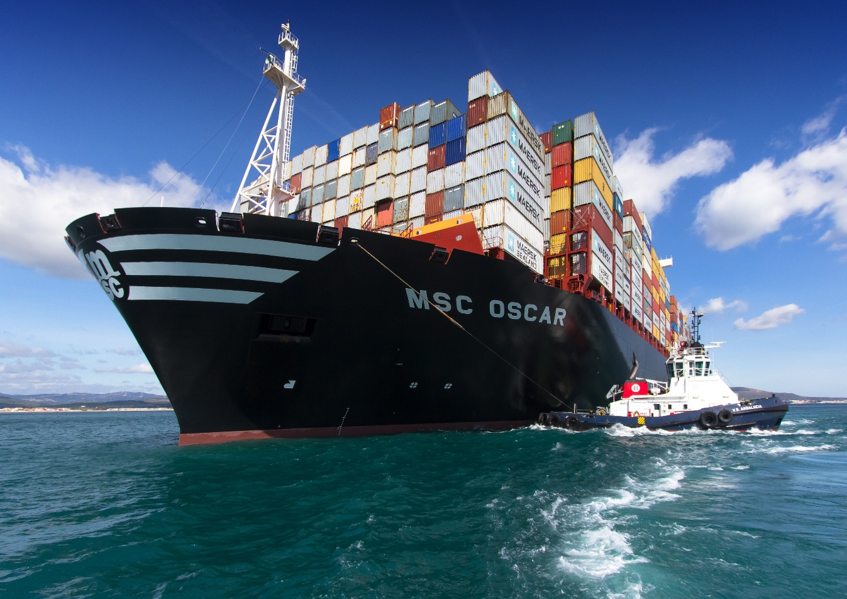

BOLUDA TOWAGE
BOLUDA.EU
Boluda Towage is one of the world’s leaders in maritime services.
The company has a worldwide presence and operates a fleet of more than 762 vessels in 184 ports in 39 countries on 5 continents over the world. Next to port towage, the company also provides offshore & ocean towage and salvage operations.
KEY NUMBERS
762 | 184 | 39 | 5
VESSELS | PORTS | COUNTRIES | CONTINENTS

Slide 23
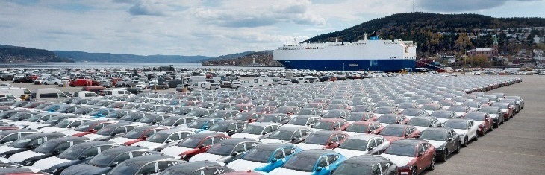
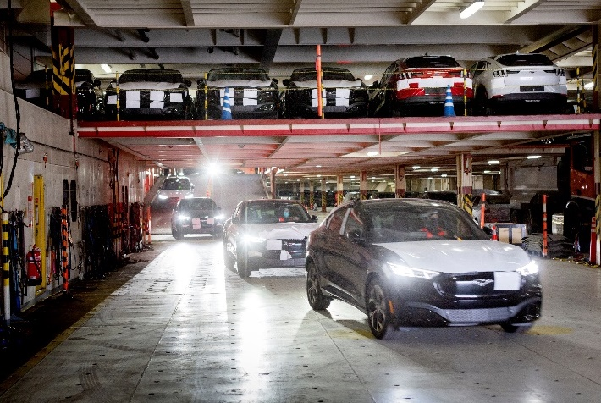
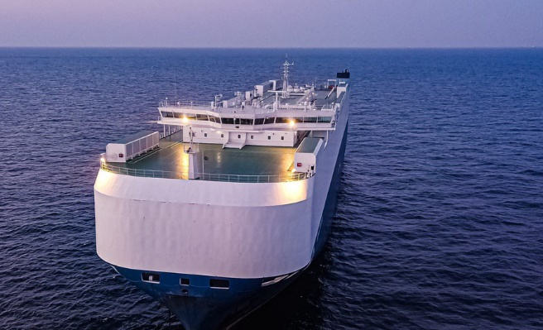
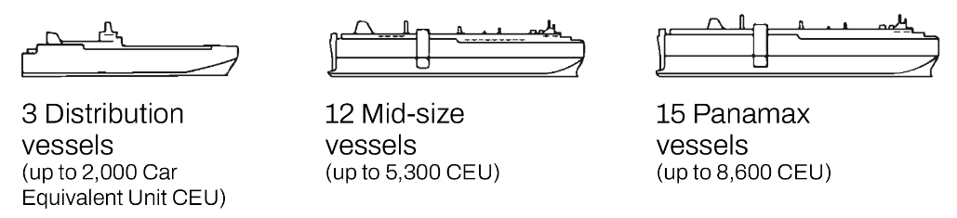

GCC GLOBAL Car Carriers
GLOBALCAR.NO
GCC Global Car Carriers (GCC) is the world's third-largest tonnage provider within the Pure Car Truck Carriers (PCTCs) segment with 30 vessels.
The company provides vessels and logistics solutions ensuring safe and efficient shipment of vehicles for a network of clients comprising of major global and regional PCTC operators.
With a strong foundation and more than 40 years of involvement in the global car shipping market, GCC is an essential and supportive partner to the global automotive industry, as vehicles and their logistic chain transition towards a zero-emission future.
KEY NUMBERS
30 | 99% | 100% | 500K | 16
VESSELS | UTILIZATION | FIXED CONTRACT BACKLOG IN 2025 | LIFTING CARS’ CAPACITY ANNUALLY | EMPLOYEES IN OSLO AND SINGAPORE

Slide 24
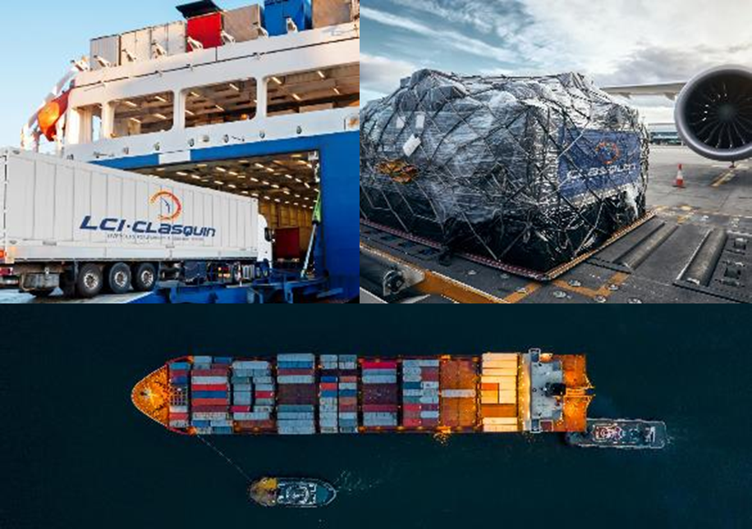
CLASQUIN clasquin.com
CLASQUIN is an international transport organizer headquartered in Lyon, France.
The group operates in the overseas field and coordinates sea, air and overland transport operations on behalf of its clients.
CLASQUIN offers tailor-made solutions that cover the entire supply chain, from the collection of the goods to their final distribution. Each transport operation mobilizes about ten providers throughout the world, all coordinated by teams of experts.
KEY NUMBERS
1.7K | 25 | 85
EXPERTS | COUNTRIES | OFFICES

Slide 25
PASSENGER DIVISION

Slide 26
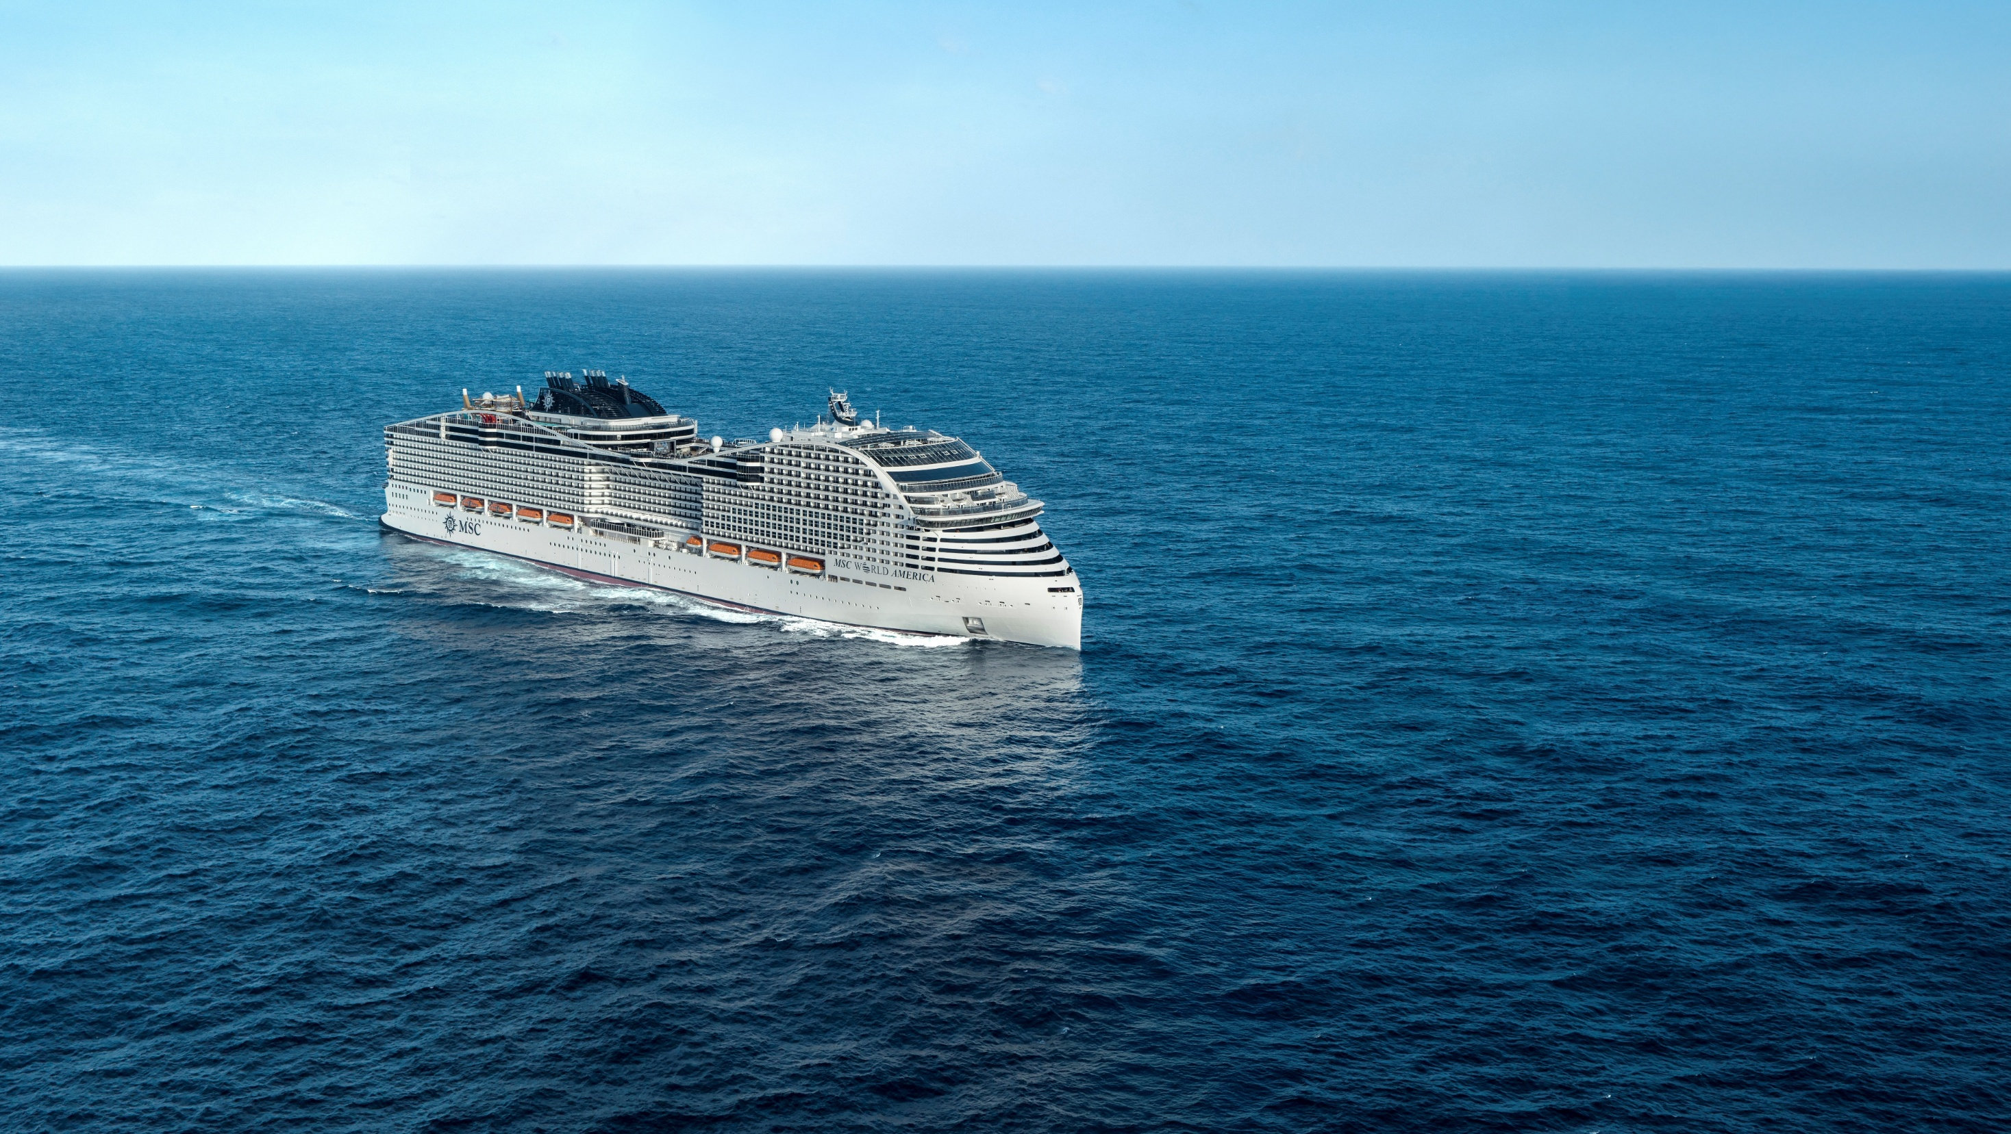

MSC CRUISES the contemporary brand
The world’s third-largest cruise brand
Market leader in Europe and South Africa
A strong, growing presence in North America and the Caribbean
SAILING TO
100+
COUNTRIES
250+
DESTINATIONS
185
NATIONALITIES WELCOMED ON BOARD
5M
GUESTS SAILED IN 2025
MSC YACHT CLUB: EXCLUSIVITY AND PRIVACY IN A WORLD OF CHOICE
From its elegant suites to its round-the-clock butler service, the MSC Yacht Club offers an all-inclusive cruise experience that combines exclusivity and privacy, while still giving you access to all the vibrant activities available on board.
www.msccruises.com

Slide 27
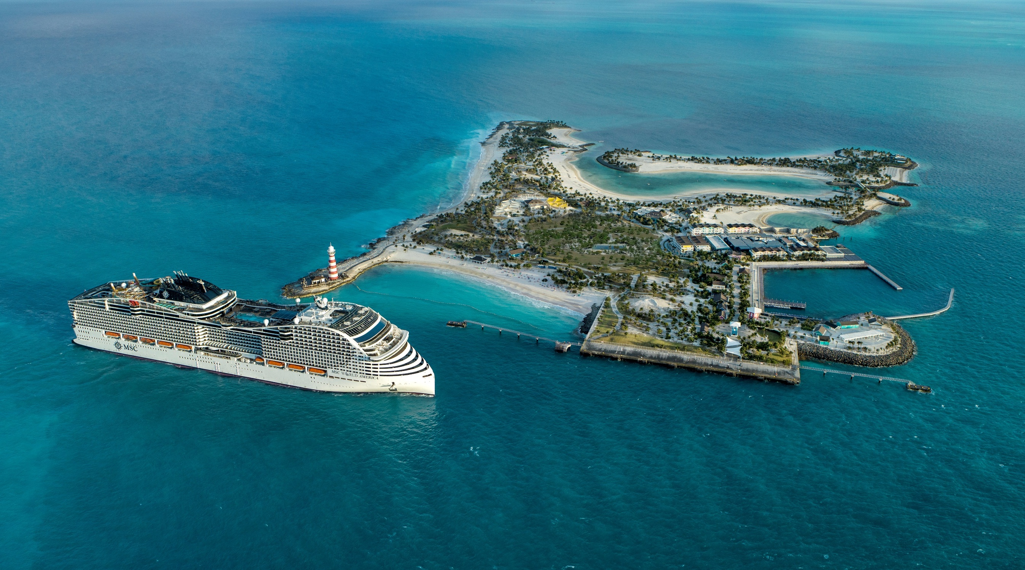
Ocean Cay MSC Marine Reserve
64
SQUARE MILES
OF WATERS
SURROUNDING THE ISLAND
10
CORAL TREES
IN THE CORAL NURSERY
38
HECTARES OF LAND
3
SURROUNDING CAYS
75,000
SHRUBS AND PLANTS
8
PRISTINE BEACHES

Slide 28
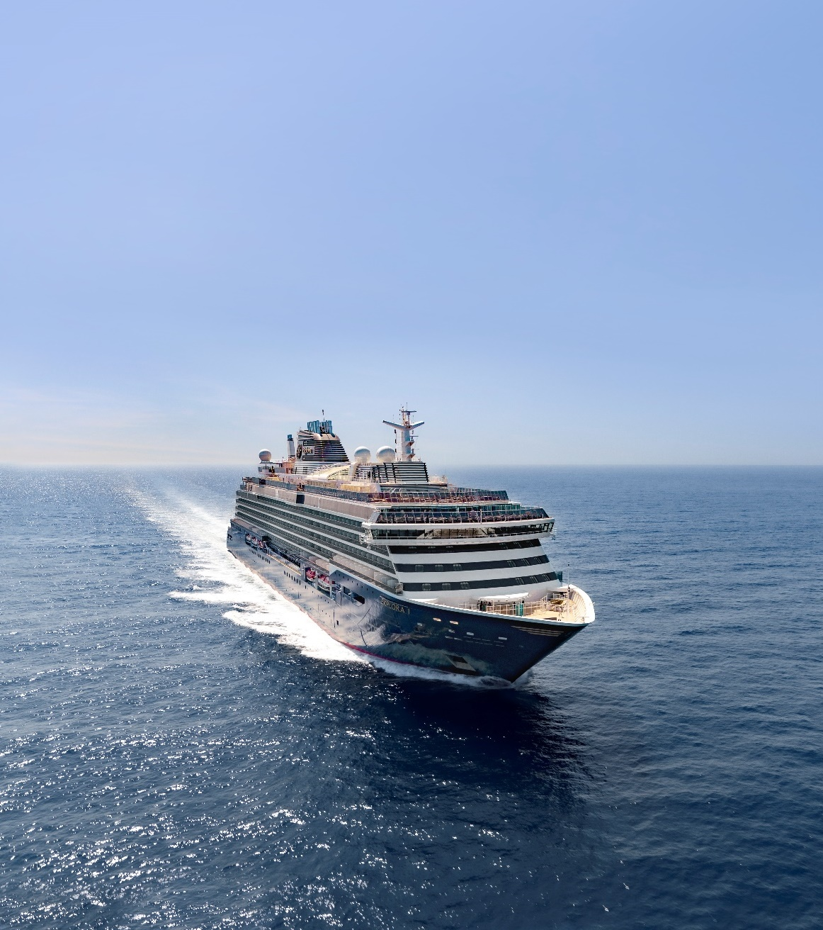

DISCOVER THE
OCEAN STATE OF MIND
The luxury lifestyle travel brand of MSC Group
Redefining luxury cruises into ocean journeys
of inner and outer discovery
3 luxury ships in operation by end of 2026
A fleet of 6 luxury ships by end of 2028
461 ocean-front suites with private terraces,
starting at 35 sqm (377sq ft), largest in the category
18 restaurants, bars and lounges, widest choice in the category
Ocean-inspired wellness and fitness
Reimagined entertainment and enrichment experiences
Generous outdoor decks featuring 3 heated pools
and multiple whirlpools
EXPLORAJOURNEYS.COM

Slide 29


CTL MARITIME
STRATEGIC DESTINATION DEVELOPMENT
Newly established port development and infrastructure entity within MSC Group’s Cruise Division
Shaping the next generation of cruise terminals and destinations worldwide
Two landmark terminal inaugurations in 2025 for MSC Cruises at:
  PortMiami — the world’s largest cruise terminal
  Port of Barcelona — the Mediterranean’s state-of-the-art cruise terminal
Advancing MSC’s destination portfolio with the continued development of Ocean Cay in The Bahamas
KEY NUMBERS
11 | 3 | 3 | 10 | 5
CRUISE TERMINALS | PRIVATE ISLANDS | ONGOING DEVELOPMENTS | COUNTRIES | CONTINENTS

Slide 30


CTL MARITIME
A GLOBAL PRESENCE
EMEA
10 projects
USA
Miami
JAPAN
Naha
Asia
3 projects
America &
Caribbean
10 projects
CARIBBEAN
Ocean Cay
EUROPE
Barcelona
Marseille
Bari & Brindisi
Palermo
Trieste
Venice
La Spezia
AFRICA
La Goulette
Durban
Pomene
Portuguese Island
LATIN AMERICA
Punta del Este

Slide 31


GNV
WWW.GNV.IT
SNAV
WWW.SNAV.IT
GNV (Grandi Navi Veloci) is a leading European shipping company operating in passenger and freight maritime transport across the Mediterranean Sea. The Company continuously invests in service enhancement, route network optimization, and in improving the environmental sustainability of its fleet.
SNAV operates ferry services in Italy and Croatia. The company includes a number of high-speed modern crafts, creating fast attractive route options within Italy, in the Gulf of Naples (Capri, Ischia, Procida, Positano, Castellammare and Sorrento), Aeolian Islands and Pontine Islands. The SNAV fleet comprises high-speed vessels, hydrofoils and catamarans.
KEY NUMBERS
KEY NUMBERS
30 | 33 | 21 | 8
SHIPS (2 ships to be added in Spring 2026) | MAJOR ROUTES | PRIME DESTINATIONS | COUNTRIES (including Italy, France, Spain, Morocco, Tunisia, Albania, Algeria, Malta)
16 | 1 | 8 | 2 | 21 | 94 | 4.8M
FAST FERRIES | CRUISE FERRY | RORO PAX FERRIES | NEW ECO-SUSTAINABLE HSC PASSENGER FAST FERRIES | ROUTES | CONNECTIONS / DAY | PASSENGERS IN 2025

Slide 32



italo the first Italian private operator on the high-speed rail network.
Italo current fleet is composed of 25 latest-generation AGV 575 trains able to travel at very high speed, up to 300 km/h, and 26 Italo EVO trains, an evolution of the "Pendolino" family, designed to travel at a max speed of 250 km/h, both comply to the most recent community safety standard requirements.
In May 2023, Italo acquired Itabus, the private long-distance road transport company. Itabus offers both long distance and intermodal services, including train and bus connections to link big cities, small towns and infrastructure hubs in Italy.
More info on www.italospa.italotreno.it
KEY NUMBERS
25 | 26 | 120 | 100 | 1.5k
LATEST-GENERATION AGV 575 TRAINS | ITALO EVO TRAINS | SERVICES PER DAY | BUSES | EMPLOYEES

Slide 33
OTHER ENTITIES

Slide 34






MSC FOUNDATION mscfoundation.org
The MSC Foundation is the philanthropic arm of the MSC Group. Established in 2018 as a non-profit organization, the Foundation aims to advance the Group’s commitments in marine conservation, humanitarian aid and sustainable development worldwide.
OUR MISSION
“TO UTILISE MSC’S GLOBAL REACH AND UNIQUE KNOWLEDGE OF THE SEA TO TAKE IMMEDIATE ACTION
THAT CONTRIBUTES TO PROTECTING AND NURTURING
THE BLUE PLANET AND ITS PEOPLE”
PROGRAMMES AND INITIATIVES AROUND THE WORLD
THE LEARNING BRIDGE
PHILIPPINES
PARTNER: UNICEF
THE SHIPS OF HOPE
AFRICA
PARTNER: MERCY SHIPS
TEACHING CARE OF THE SEAS
ITALY, SPAIN, PORTUGAL, GREECE
PARTNER: MAREVIVO
KEY NUMBERS
2.7M+ | 100 | 22 | 169 | 82 | 72
DIRECT BENEFICIARIES | PROGRAMMES & INITIATIVES | PARTNERS | BENEFICIARY ORGANIZATIONS | EMERGENCY RELIEF OPERATIONS | COUNTRIES REACHED
ASSISTENZA D’EMERGENZA
SUPER CORAL REEFS PROGRAMME
OCEAN CAY, THE BAHAMAS
CORAL BIODIVERSITY ASSESSMENT
WORLDWIDE
PARTNER: IUCN

Slide 35





Mediclinic group
Mediclinic.com
In May 2023, MSC completed the acquisition of the international private healthcare services group, Mediclinic International plc (now Mediclinic Group), as part of a consortium alongside Remgro Ltd.
Established in South Africa in 1983, Mediclinic has divisions in Switzerland, Southern Africa (South Africa and Namibia) and the Middle East. It aims to offer a wide range of services from experts in different fields of healthcare, covering all stages of care, so that the Group can earn the trust and respect of its clients, doctors, funders and healthcare regulators in every market it operates in.
In Switzerland, Mediclinic Group operates under the Hirslanden brand with 16 hospitals, 1.8K beds, and 14K employees.
MEDICLINIC OPERATIONS
KEY NUMBERS
72 | 6 | 6 | 11.7K | 21 | 28 | 38K
HOSPITALS | SUBACUTE HOSPITALS | MENTAL HEALTH FACILITIES | BEDS | DAY CASE CLINICS | OUTPATIENT CLINICS | EMPLOYEES

